Slide 1

Adventure Works
Joran Vergauwen

Slide 2
Overview
Current Sales
Customers
Sales People
Tackling Churn

Slide 3


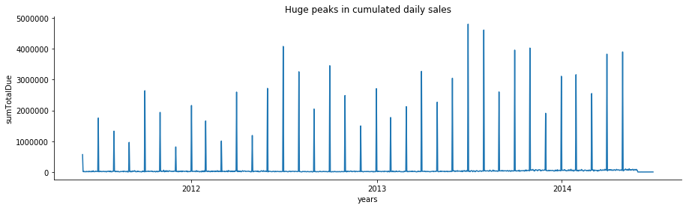
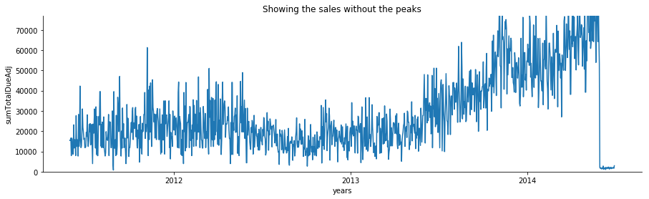
Monetary sales consist of 2 parts
Spiky
Sales
Continuous Sales

Slide 4
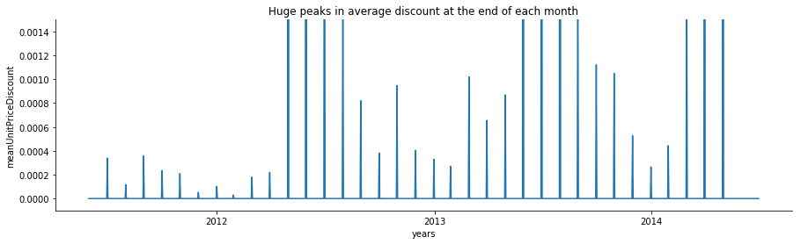
Sales peaks occur with discount peaks
Spiky Sales
Average Discounts

Slide 5
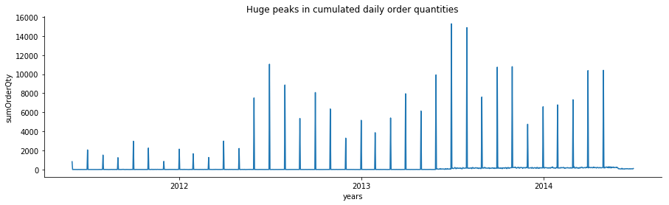
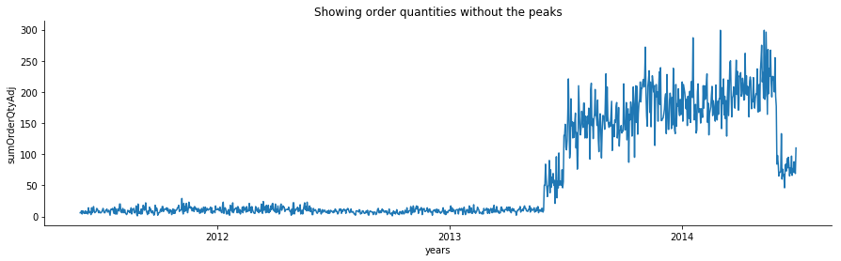
Order Quantities consist of 2 parts
Spiky Order Quantities
Continuous Order
Quantities

Slide 6

Increase is mainly due to online sales
Number of
Online Sales
Continuous Order
Quantities

Slide 7
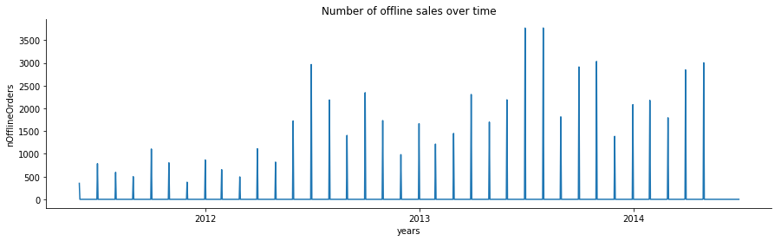
Order Quantities consist of 2 parts
Spiky Order Quantities
Continuous Order
Quantities

Slide 8
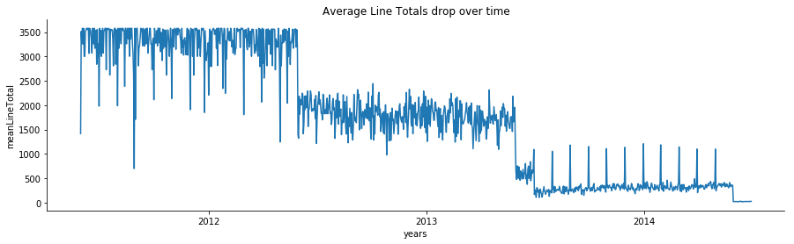
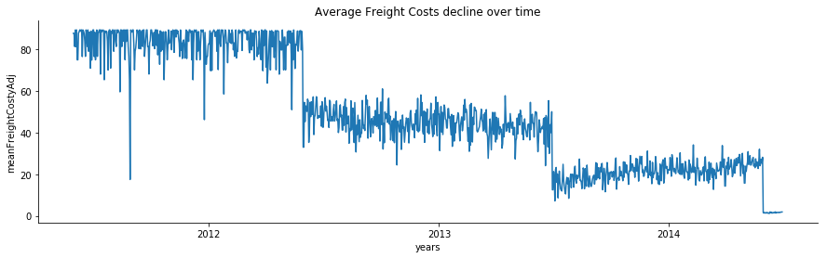
Order Quantities consist of 2 parts
Average Line
Totals
Average Freight
Costs over time

Slide 9
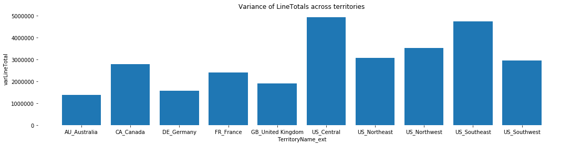
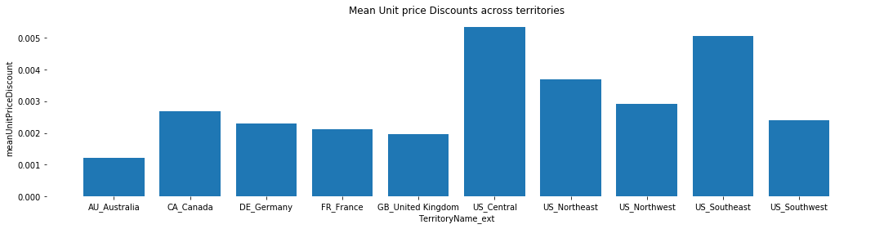
Territories with highest fluctuations in sales
Fluctuation in Sales
per
Territory
Average
Discount per Territory

Slide 10
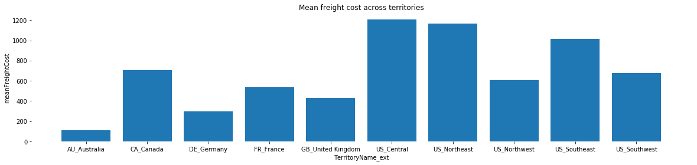
Territories with highest fluctuations in sales
Fluctuation in Sales
per
Territory
Average Freight
Costs per Territory

Slide 11
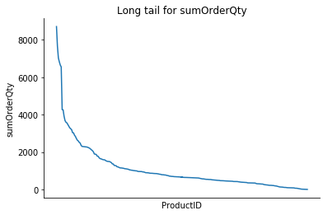
There is a “Long Tail” for the product sales

Slide 12

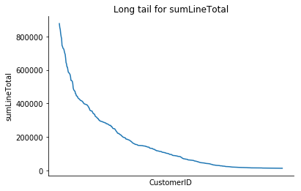
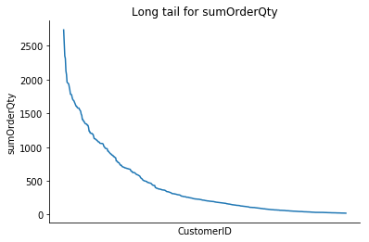
How important are our top customers?

Slide 13
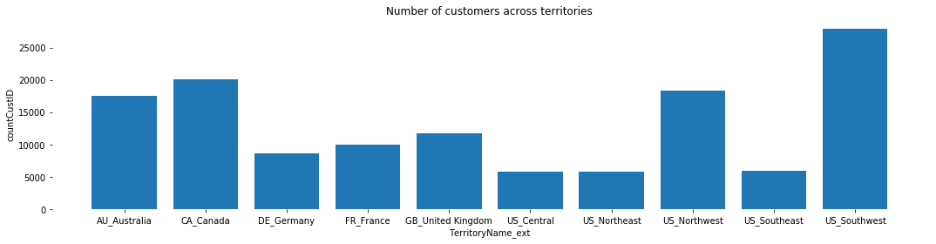
Number of customers for each territory

Slide 14
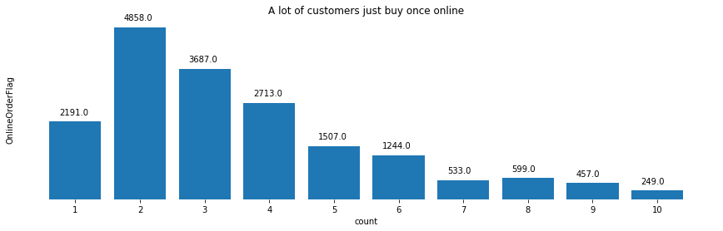
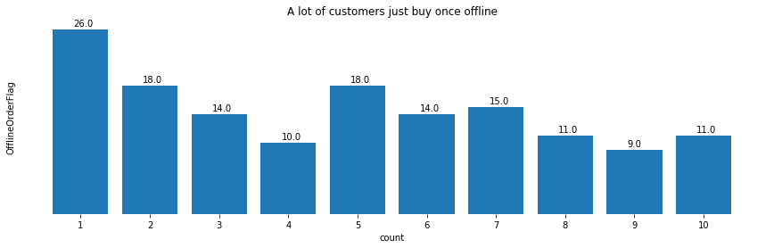
A lot of people only have a few orders!
Online Sales
Offline Sales

Slide 15
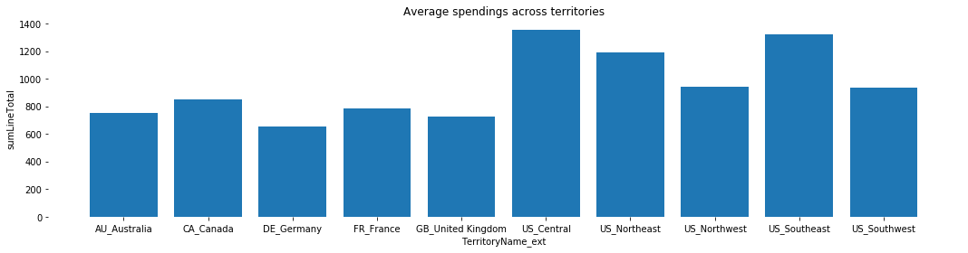
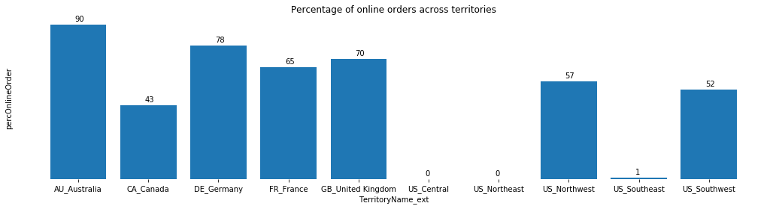
Customers across territories
Average Sales Total
Percentage Online Sales

Slide 16
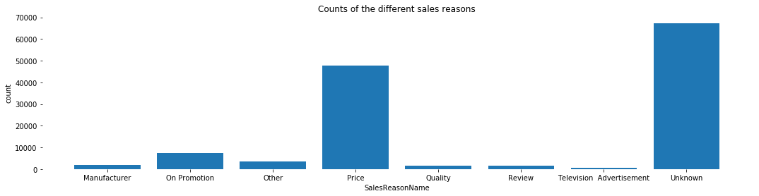
Price is the most important sales reason!

Slide 17

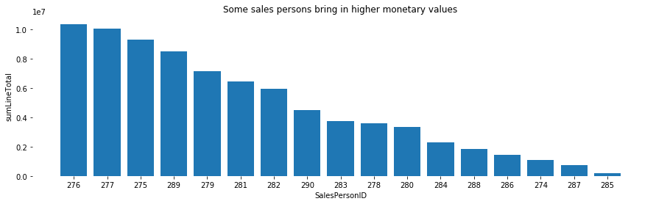
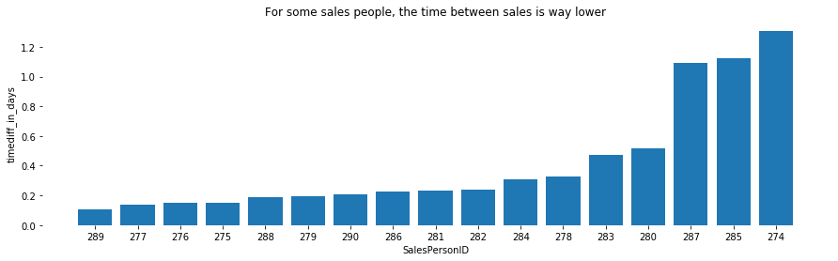
Who are our best sales people?
In Total Sales
Time between
Sales

Slide 18

Predicting churn: the predictors
Recency
Frequency
Monetary value: total
Monetary value: average
Tenure
TerritoryID (multiple values allowed)
Online/ Offline order
Credit Card Payer
Discount buyer
Order quantity: average
Order quantity: max

Slide 19
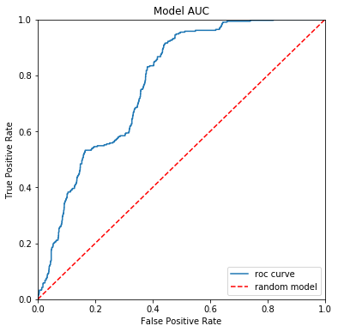
Model: some insights
AUC: 0,77
When ordering the customers: A churner has 77% more chance to be reported before a non-churner

Slide 20
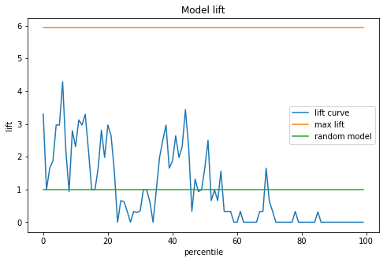
The model: some insights
Until about 20% of the customers with the highest churn probabilities, the model clearly performs better than randomly selecting customers

Slide 21
Thank you!

Slide 22
Extra slides

Slide 23
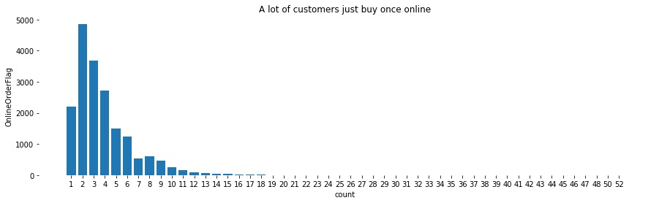
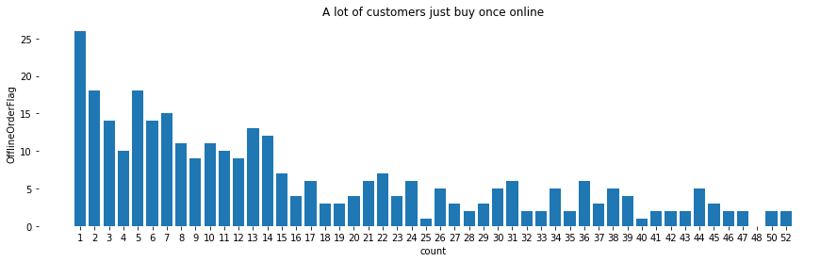
Online sales tend to “die out” faster
Online Sales
Offline Sales

Slide 24
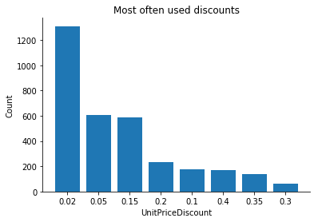
Most used discounts

Slide 25
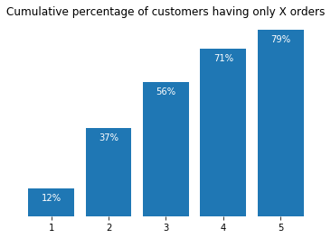
Most used discounts

Slide 26
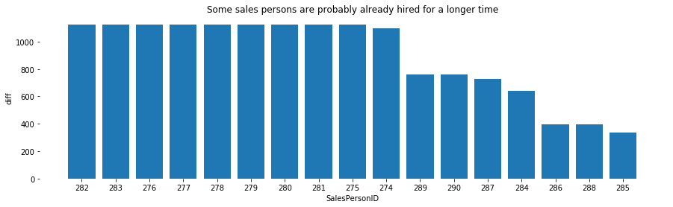
Tenure of sales people

Slide 27
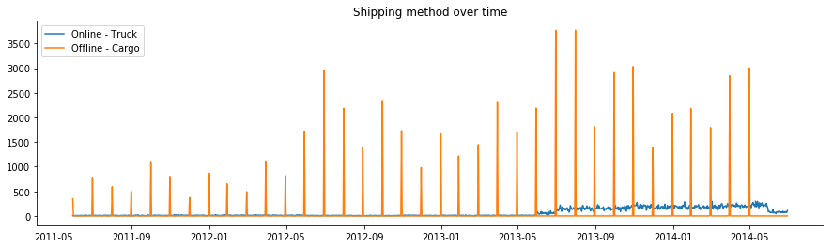
Shipping over time

